Slide 1

Quantum Machine Learning for Intrusion Detection on Noisy Quantum Computers
Franco Cirillo and Christian Esposito
University of Salerno
fracirillo@unisa.it
IEEE International Conference on Quantum Computing and Engineering 2025 (QCE2025)

Slide 2

Introduction
Intrusion Detection Systems (IDS) play a critical role in ensuring security.
Anomaly detection has proven to be an effective approach for intrusion detection, establishing a baseline of normal system.
ML has emerged as a powerful tool, enabling systems to automatically classify network traffic as normal or malicious.
Quantum Machine Learning for Intrusion Detection on Noisy Quantum Computers – Franco Cirillo – fracirillo@unisa.it
Notes:
Intrusion Detection Systems (IDS) play a critical role in ensuring the security and integrity of digital infrastructures by identifying malicious activities, unauthorized access, or policy violations.
Among the various detection techniques, anomaly detection has proven to be an effective approach for intrusion detection, these methods establish a baseline of normal system or network behavior. Any deviation from this baseline is flagged as a potential intrusion.
In recent years, machine learning (ML) has emerged as a powerful tool for both intrusion and anomaly detection. ML techniques excel at learning complex patterns, enabling systems to automatically classify network traffic as normal or malicious.

Slide 3
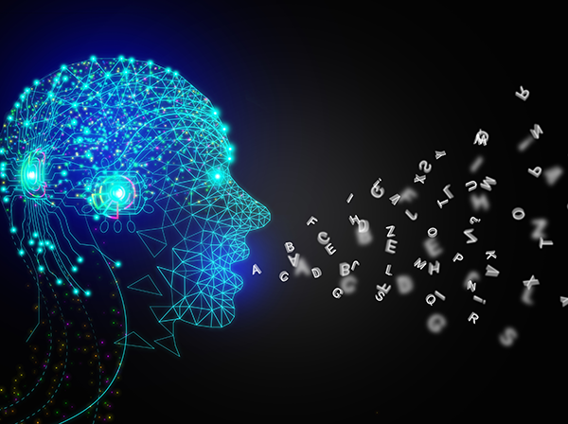
Introduction
Quantum Machine Learning (QML) has the potential to outperform classical methods.
QML can handle complex, high-dimensional data more efficiently, leading to faster training times .
Quantum Support Vector Machines (QSVM), Variational Quantum Classifiers (VQC), and hybrid quantum-classical neural networks
Quantum Machine Learning for Intrusion Detection on Noisy Quantum Computers – Franco Cirillo – fracirillo@unisa.it
Notes:
In parallel, Quantum Machine Learning (QML) is gaining traction as a next-generation approach, with the potential to outperform classical methods in certain contexts.
Leveraging quantum parallelism and state representation capabilities, QML can handle complex, high-dimensional data more efficiently, potentially leading to faster training times and improved detection performance.
Among the most actively studied QML paradigms are Quantum Support Vector Machines (QSVM), Variational Quantum Classifiers (VQC), and hybrid quantum-classical neural networks

Slide 4
QSVM
Similarly to SVM, the kernel trick is used to map data into a higher-dimensional space after transforming the data into a quantum feature space.
Data
Feature Map
Quantum Kernel
Classifier
|0⟩
.
.
.
|0⟩
Qubits
Quantum Machine Learning for Intrusion Detection on Noisy Quantum Computers – Franco Cirillo – fracirillo@unisa.it
Notes:
One of particular interest is the Quantum Support Vector Machine (QSVM), a quantum version of the classical Support Vector Machine (SVM) algorithm.
Similarly to SVM, the kernel trick is used to map data into a higher-dimensional space after transforming the data into a quantum feature space.
So, classical data is transformed in quantum states with FM, and optimizing the algo we obtain the classifier.

Slide 5
Pegasos-QSVC
Inspired by the Pegasos algorithm (Primal Estimated sub-GrAdient SOlver for SVM), it employs a stochastic gradient descent approach to solve the primal optimization problem of SVMs.
Pegasos updates model parameters using only a small subset of the data, thereby reducing computational costs and ensuring training complexity is independent of the training set size.
Quantum Machine Learning for Intrusion Detection on Noisy Quantum Computers – Franco Cirillo – fracirillo@unisa.it
Notes:
Another algorithm based on SVM that utilizes the quantum kernel method is the Pegasos-QSVC.
Inspired by the Pegasos algorithm (Primal Estimated sub-GrAdient SOlver for SVM), it employs a stochastic gradient descent approach to solve the primal optimization problem of SVMs. Unlike standard SVMs, which require processing the entire dataset at each iteration, Pegasos updates model parameters using only a small subset of the data, thereby reducing computational costs and ensuring training complexity is independent of the training set size.

Slide 6
VQC
It employs a parameterized quantum circuit trained with classical optimization methods to perform classification tasks.
As a type of variational quantum algorithm (VQA), the VQC depends heavily on the choice of ansatz.
Data
Feature Map
Variational Circuit
Measurement
Optimizer
|0⟩
.
.
.
|0⟩
Updating weights
Qubits
Quantum Machine Learning for Intrusion Detection on Noisy Quantum Computers – Franco Cirillo – fracirillo@unisa.it
Notes:
The VQC is a quantum model inspired by classical neural networks, particularly the multilayer perceptron.
It employs a parameterized quantum circuit trained with classical optimization methods to perform classification tasks. As a type of variational quantum algorithm (VQA), the VQC depends heavily on the choice of ansatz, the structure of the quantum circuit, which directly affects the algorithm’s expressiveness and performance.

Slide 7
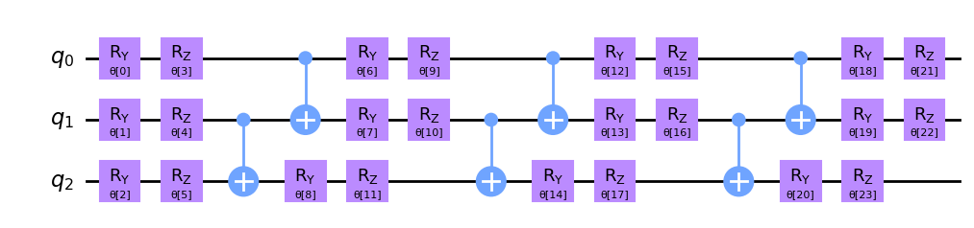
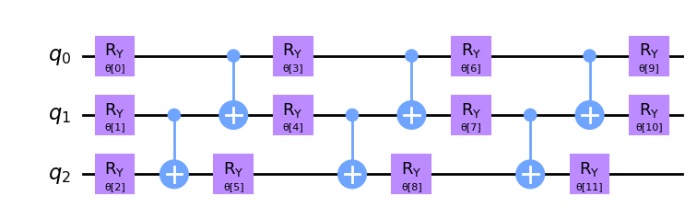
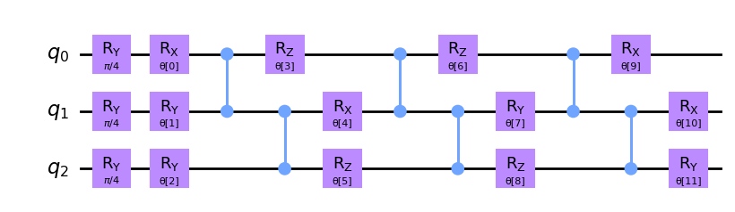
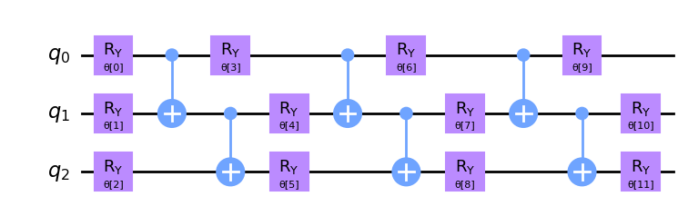
Ansatz
Similarly to SVM, the kernel trick is used to map data into a higher-dimensional space after transforming the data into a quantum feature space.
Quantum Machine Learning for Intrusion Detection on Noisy Quantum Computers – Franco Cirillo – fracirillo@unisa.it
Notes:
In this work, we explore four specific ansatzes: Two-Local, Pauli Two-Design, Real Amplitudes, and EfficientSU2, each designed with distinct features and trade-offs suited to various quantum computing problems.
Two-Local is a variational quantum circuit composed of repeated layers of rotations and entanglement. Standard gates commonly used in the literature and defined in the documentation have been applied: \(R_Y\) gates for rotations and \(CX\) gates for entanglement. \begin{figure}[h] \centering \includegraphics[width=0.48\textwidth]{Figure/twolocal.png} \caption{Example of a Two-Local circuit with 3 qubits and 3 repetitions.}\end{figure}Pauli Two-Design is a variant of the Two-Local. It starts with an initial rotation around the \(Y\)-axis with an angle of \(\frac{\pi}{4}\). The subsequent layers alternate between rotations around the \(X\), \(Y\), or \(Z\) axes and entanglement layers. \begin{figure}[h] \centering \includegraphics[width=0.48\textwidth]{Figure/PauliTwoDesign.png} \caption{Example of a Pauli Two-Design circuit with 3 qubits and 3 repetitions.}\end{figure}Real Amplitudes is also derived from the Two-Local. It generates a trial wavefunction by repeatedly applying rotations around the \(Y\)-axis on the qubits and using \(CX\) gates for entanglement. As the name suggests, the wavefunction amplitudes are restricted to real values, which can simplify the optimization problem in some cases.\begin{figure}[h] \centering \includegraphics[width=0.48\textwidth]{Figure/realamplitudes.png} \caption{Example of a Real Amplitudes circuit with 3 qubits and 3 repetitions.}\end{figure}EfficientSU2 is a hardware-efficient variational quantum circuit. The name SU2 refers to the special unitary group of dimension 2, which includes all \(2 \times 2\) complex matrices with a determinant equal to 1. Compared to other ansatzes, it uses a larger number of rotation gates, combining \(R_Y\) and \(R_Z\) rotations in each repetition.
Optimizers…

Slide 8
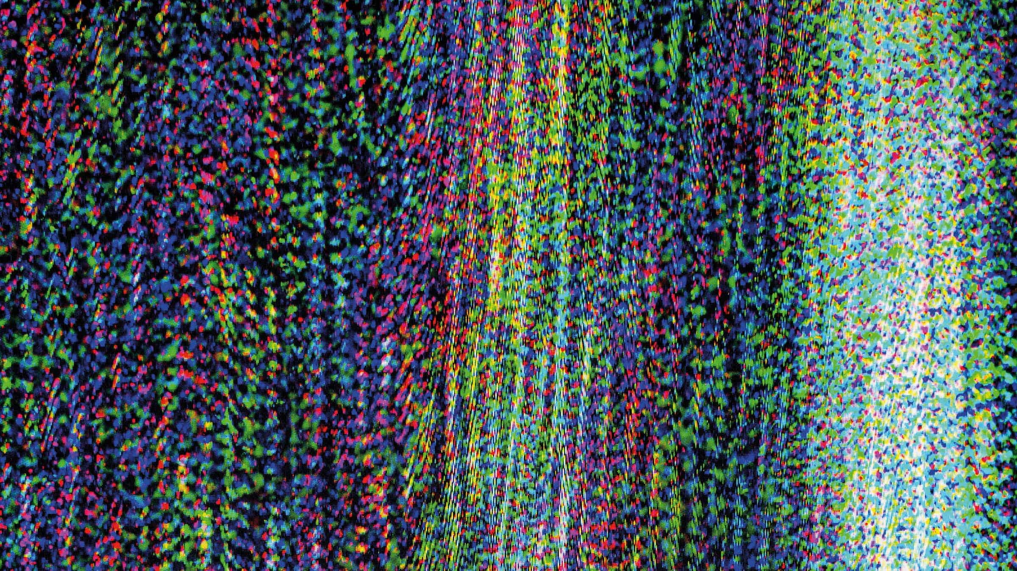
Quantum Noise
The presence of noise in current quantum hardware remains a major challenge
Evaluations that ignore these aspects may falsify the true capabilities of QML models.
While testing on real quantum machines is valuable for validation, it is often resource-intensive and costly.
Quantum Machine Learning for Intrusion Detection on Noisy Quantum Computers – Franco Cirillo – fracirillo@unisa.it
Notes:
However, the presence of noise in current quantum hardware remains a major challenge, often degrading the reliability and stability of QML models.
Evaluations that ignore these aspects may falsify the true capabilities of QML models.
While testing on real quantum machines is valuable for validation, it is often resource-intensive and costly.

Slide 9
State of the art
Although existing studies exhibit strong performance across diverse datasets, their resilience to noise either remains unaddressed or yields limited results.
Moreover, they do not provide a systematic analysis of the impact of circuit design on noise resilience.
Quantum Machine Learning for Intrusion Detection on Noisy Quantum Computers – Franco Cirillo – fracirillo@unisa.it
Notes:
Although existing studies exhibit strong performance across diverse datasets, their resilience to noise either remains unaddressed or yields limited results.
Moreover, they do not provide a systematic analysis of the impact of circuit design on noise resilience, limiting the practical applicability of current approaches to real quantum hardware environments.

Slide 10
Objective
Noisy quantum simulators emulate real hardware imperfections, enabling the testing of QML architectures under more realistic conditions.
Performance analysis of Pegasos-QSVC, VQC, and hybrid quantum-classical neural networks.
Validation of the top-performing configurations using IBM's noisy quantum simulators.
Analysis of circuit design choices to determine their impact on noise resilience.
Key Contribution
Quantum Machine Learning for Intrusion Detection on Noisy Quantum Computers – Franco Cirillo – fracirillo@unisa.it
Notes:
An effective compromise is the adoption of noisy quantum simulators, such as those offered by IBM, which allow for controlled testing environments that emulate real hardware imperfections. These platforms support the refinement of QML architectures under more realistic conditions, enabling researchers to assess model resilience and devise strategies for noise mitigation without incurring high operational costs.
This work makes the following key contributions:
An in-depth analysis of the performance of Pegasos-QSVC, VQC, and hybrid quantum-classical neural networks, evaluated using the ToN\_IoT dataset across various model configurations.
Experimental validation of the top-performing configurations using IBM's noisy quantum simulators, providing a meaningful contribution to the field by assessing QML robustness in noisy environments.
An in-depth analysis of circuit design choices to determine their impact on noise resilience, offering a practical guidelines for selecting quantum circuit structures optimized for specific noise profiles.

Slide 11










Dataset & Preprocessing
TON_IOT dataset, a next-generation dataset collection for Industry 4.0.
PCA with different numbers of principal components.
Min-Max scaling in range [0, 1] .
SCANNING
PASSWORD
CRACKING
RANSOMWARE
XSS
MIMT
DDOS
INJECTION
DOS
BACKDOOR
Quantum Machine Learning for Intrusion Detection on Noisy Quantum Computers – Franco Cirillo – fracirillo@unisa.it
Notes:
The dataset used in this research is the "TON\_IoT Datasets“, a next-generation dataset collection for Industry 4.0, IoT, and Industrial IoT (IIoT), designed to evaluate the reliability and effectiveness of various artificial intelligence-based cybersecurity applications, and has been used in several works.
Different kind of attacks
The dataset was preprocessed by removing irrelevant features, handling missing values, eliminating duplicates, and encoding categorical data.
It was split into training and testing sets, min-max scaling normalized values, and PCA reduced dimensionality, ensuring the dataset was optimized for classification and quantum model compatibility.

Slide 12
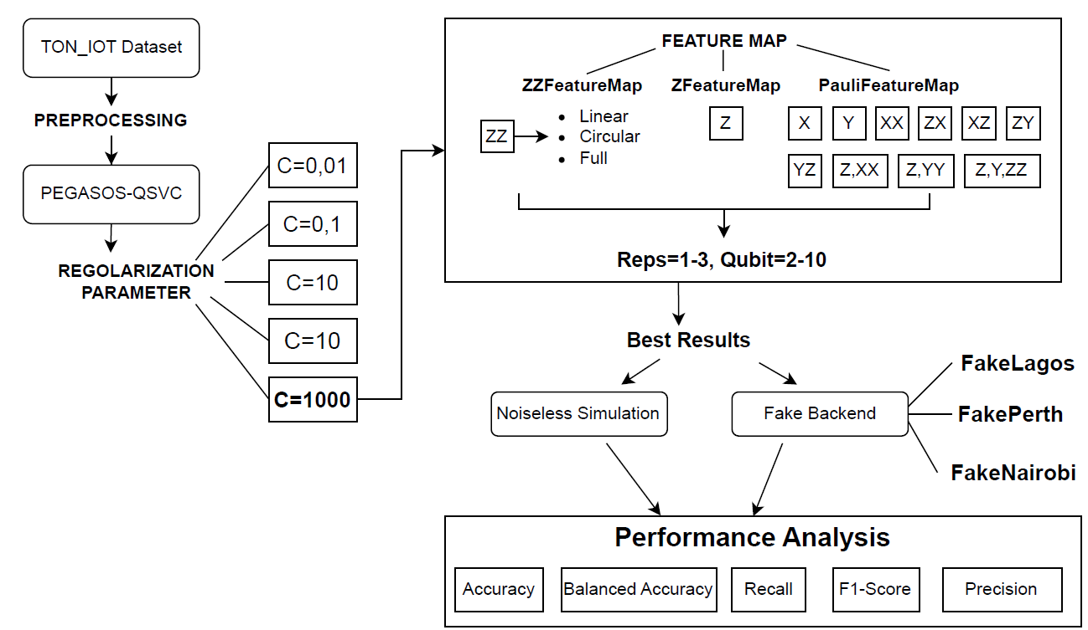
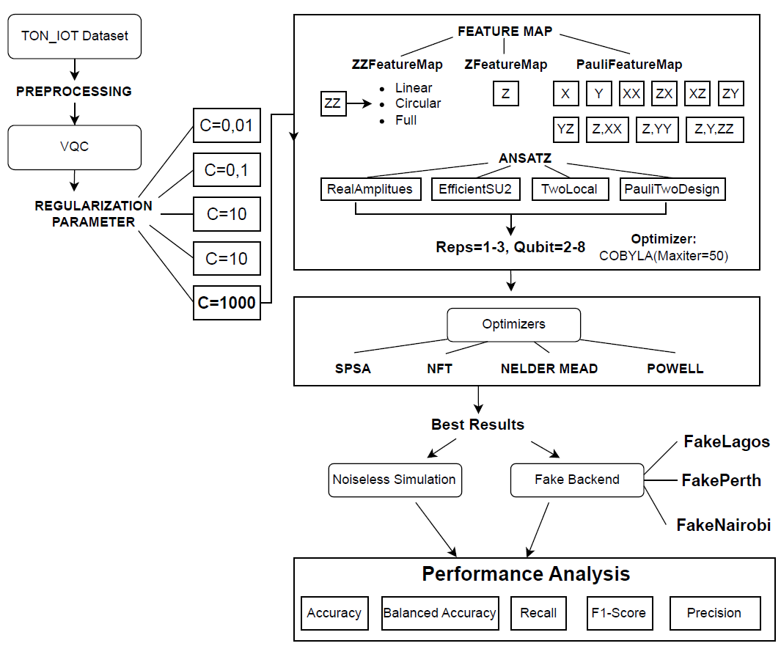
Methodology
Pegasos-QSVC
Quantum Machine Learning for Intrusion Detection on Noisy Quantum Computers – Franco Cirillo – fracirillo@unisa.it
Notes:
In this work, we have configured and evaluated three QML models.
As our QSVM model, we used the Pegasos-QSVC algorithm. The methodology for hyperparameter optimization is summarized in Figure.
Following the preprocessing stage, we tested different values of the regularization parameter to identify the optimal configuration. Subsequently, various feature maps, numbers of qubits, and repetitions (reps) were explored to assess their impact on the model's performance. The best-performing configurations were then evaluated on noisy quantum simulators provided by ibm to validate their robustness.

Slide 13
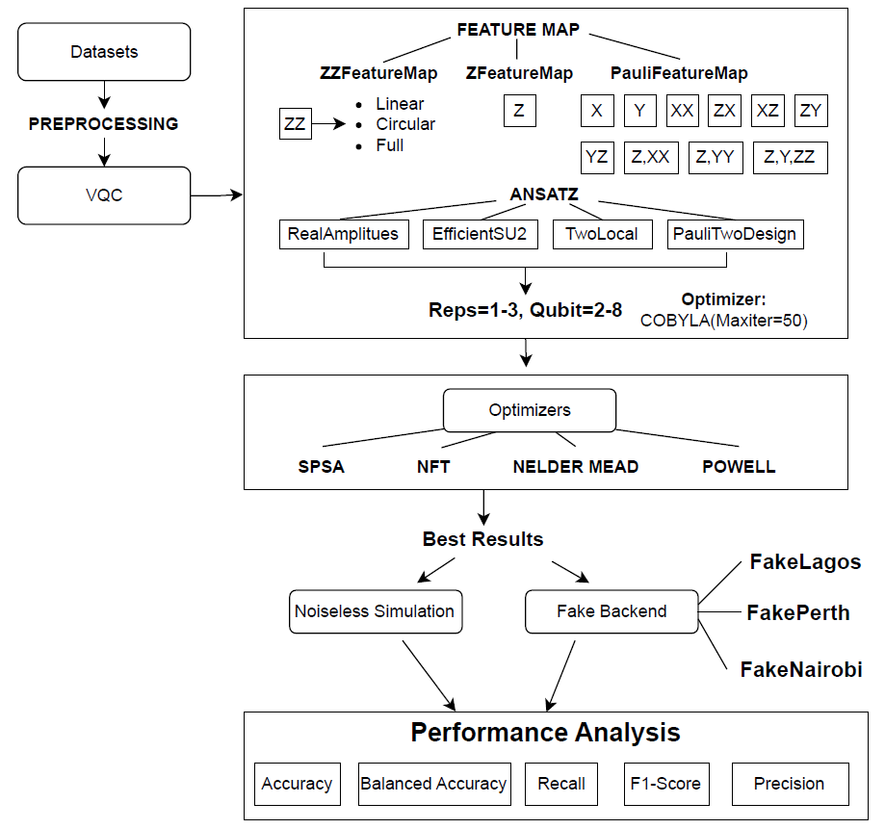
Methodology
VQC
Quantum Machine Learning for Intrusion Detection on Noisy Quantum Computers – Franco Cirillo – fracirillo@unisa.it
Notes:
For the VQC model, different ansatz designs and optimizers were tested to optimize the performance of the classifier.

Slide 14
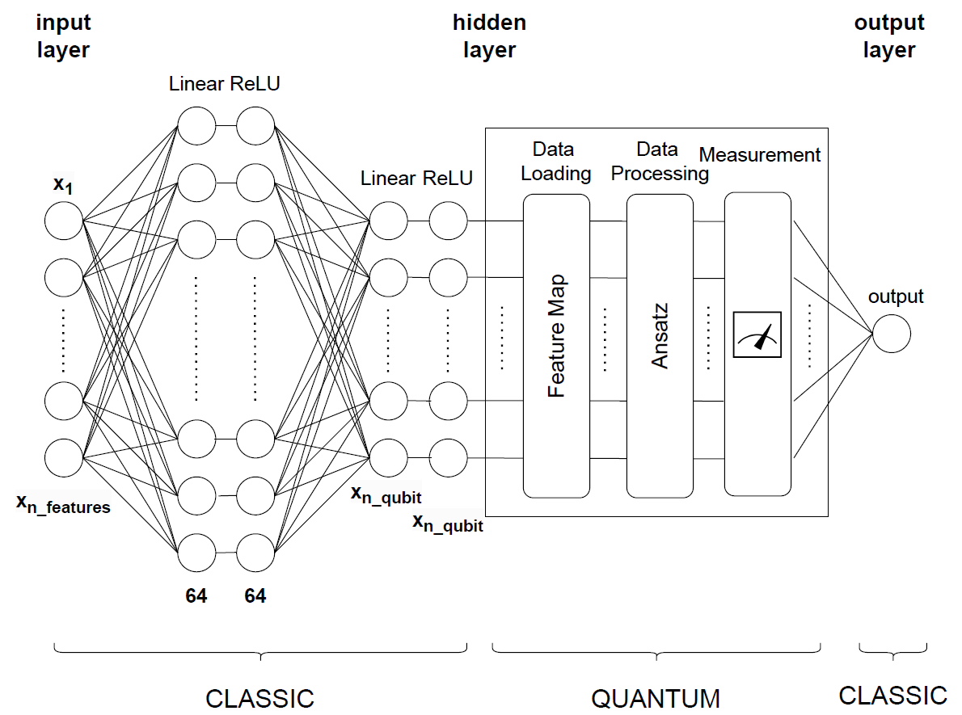
Methodology
Hybrid quantum-classical neural network
Quantum Machine Learning for Intrusion Detection on Noisy Quantum Computers – Franco Cirillo – fracirillo@unisa.it
Notes:
The structure of the hybrid quantum-classical neural network is presented in Figure. The quantum circuit used in the model consists of a feature map and an ansatz. The classical component was developed using fully connected layers, which were employed to project data from one dimension to another. Each linear layer is followed by a non-linear activation function, such as ReLU, which introduces non-linearity into the model, enabling the network to learn complex representations of the data.

Slide 15
Noisy computation
Key Performance Metrics
T1 (Relaxation Time): Time a qubit stays excited before decaying; limited by environmental interactions.
T2 (Dephasing Time): Duration a qubit remains coherent; shorter than T1 due to additional phase noise.
Readout Error: Probability of measuring the wrong qubit state, even after perfect operations.
Gate Errors:
rz: Minimal error (virtually implemented)
sx, x: Affected by control noise
cx (CNOT): Highest error rate, critical for entanglement
Quantum Machine Learning for Intrusion Detection on Noisy Quantum Computers – Franco Cirillo – fracirillo@unisa.it
Notes:
Real quantum devices suffer from imperfections and noise that degrade computational reliability: qubit decoherence, gate errors, environmental noise.
Several key metrics are critical for evaluating the performance and reliability of quantum systems, including T1, T2, readout error, and gate errors such as rz, sx, x, and cx errors.
Each metric reflects a different aspect
T1, the relaxation time, measures how long a qubit can stay in an excited state before decaying to its ground state. A longer T1 is desirable for extended computation but is limited by environmental noise and material properties. Similarly, T2, the dephasing time, indicates how long a qubit maintains coherence between quantum states, critical for superposition. T2 is often shorter than T1, as it includes both energy relaxation and phase noise. Readout error reflects inaccuracies in measuring qubit states. Even if operations are performed perfectly, high readout error can distort results. Gate errors occur during qubit operations, with rz gates typically having minimal errors due to their virtual implementation, while single-qubit gates like sx and x face challenges from control inaccuracies. The cx (CNOT) gate, essential for entanglement, often exhibits the highest error rates due to its complexity and sensitivity to noise. These metrics are deeply interconnected.

Slide 16
Noisy simulation
Noisy simulators provide a more practical alternative for evaluating several configurations.
The selected quantum circuits were tested under noisy conditions using fake backends provided by IBM, which are designed to mimic the behavior of IBM Quantum systems and are built using system snapshots.
These snapshots contain information about the simulated quantum device, such as the coupling map, which describes the physical connections between qubits, and the qubit properties.
Quantum Machine Learning for Intrusion Detection on Noisy Quantum Computers – Franco Cirillo – fracirillo@unisa.it
Notes:
Noisy simulators provide a more practical alternative for evaluating several configurations, especially for deep circuits and larger datasets.
The selected quantum circuits were tested under noisy conditions using fake backends provided by IBM, which are designed to mimic the behavior of IBM Quantum systems and are built using system snapshots.
These snapshots contain information about the simulated quantum device, such as the coupling map, which describes the physical connections between qubits, and the qubit properties.
%Noisy simulation obviously produces different results compared to the ideal one. However, starting with noise-free simulations represents a useful approach, as adding noise is computationally expensive.

Slide 17
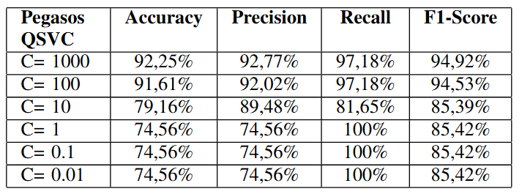
Optimization and Results
Pegasos-QSVC - Regularization parameter C
A higher C reduces penalties for misclassified points, resulting in wider margins and better generalization but increasing the risk of bias or underfitting.
Conversely, a lower C forces the algorithm to fit misclassified points more closely, leading to narrower margins and a risk of overfitting while capturing more complex patterns.
Quantum Machine Learning for Intrusion Detection on Noisy Quantum Computers – Franco Cirillo – fracirillo@unisa.it
Notes:
we outline the search parameters used for the optimization process and describe results obtained.
We first analyze…
A higher C reduces penalties for misclassified points, resulting in wider margins and better generalization but increasing the risk of bias or underfitting. Conversely, a lower C forces the algorithm to fit misclassified points more closely, leading to narrower margins and a risk of overfitting while capturing more complex patterns.
The performance of the Pegasos-QSVC algorithm was analyzed for different values of the regularization parameter \( C \), Table \ref{tab:pqsvc_performance}. Higher \( C \) values (1000 and 100) result in strong performance, with metrics exceeding 91\% and a balanced F1-Score. Therefore, \( C = 1000 \) was selected as the optimal parameter.

Slide 18
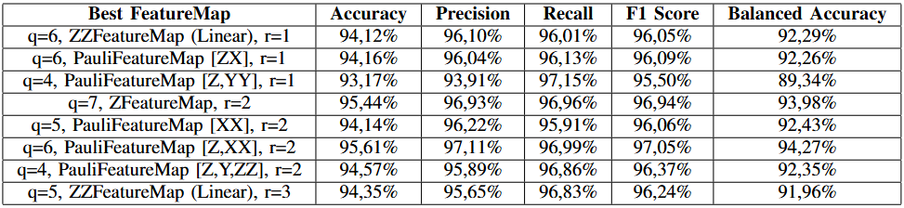
Optimization and Results
Pegasos-QSVC – Fine-tuning
2 to 10 qubits, 14 feature maps, and 1 to 3 repetitions for each -> 378 experiments
The tests were conducted initially on a noiseless simulator and subsequently on a noisy simulator to optimize the number of tests
Quantum Machine Learning for Intrusion Detection on Noisy Quantum Computers – Franco Cirillo – fracirillo@unisa.it
Notes:
After, we fine tune the model based on several parameters The total number of experimental results amounts to 378, derived from testing configurations with 2 to 10 qubits, 14 feature maps, and 1 to 3 repetitions for each feature map.
The Table \ref{tab:featuremaps_results} shows the configurations of the models which have obtained the best performances in terms of Accuracy, Precision, Recall, F1 Score and Balanced Accuracy (accuracy up to 95%)

Slide 19
Optimization and Results
Pegasos-QSVC – Fine-tuning
Qubit 4-7
Reps increase stability
ZZFeatureMap Linear, Pauli feature map, need of entanglement
Quantum Machine Learning for Intrusion Detection on Noisy Quantum Computers – Franco Cirillo – fracirillo@unisa.it
Notes:
Observing the results as a function of the number of qubits (q), the model's accuracy tends to stabilize at a certain threshold (around 6–7 qubits). This behavior indicates that the models no longer benefit from adding more qubits
Regarding the number of repetitions (r), it has been observed that increasing it tends to enhance the stability of the results. However, this does not lead to significantly better performance, while it increases the complexity of the circuit.
Regarding the FeatureMaps, the ZZFeatureMap with the Linear configuration surpasses the others. The Pauli feature map consistently ranks among the top-performing configurations. Feature maps without entanglement are less stable compared to entangled configurations but can still achieve high performance in some cases.

Slide 20
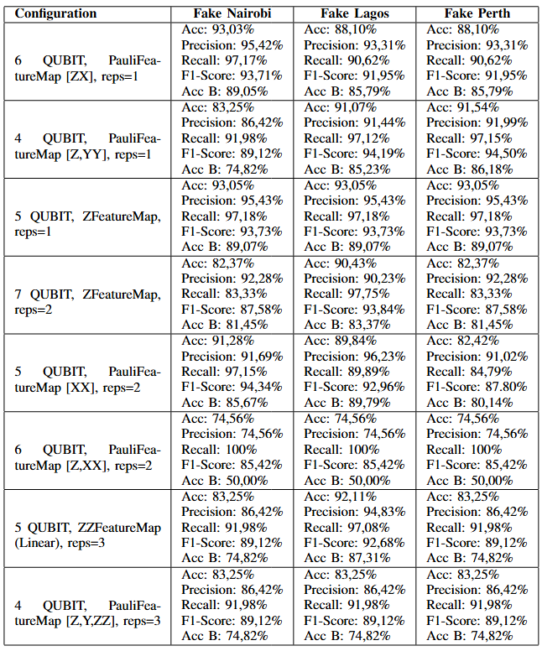
Optimization and Results
Pegasos-QSVC – Noisy simulation
Same qubits architecture with different error level.
FakeLagos -> good single-gate error probability but high two-qubit gate error and readout error.
FakeNairobi, FakePerth -> higher gate error levels but lower readout error and two-qubit gate error.
Quantum Machine Learning for Intrusion Detection on Noisy Quantum Computers – Franco Cirillo – fracirillo@unisa.it
Notes:
Since the maximum number of qubits used in the selected combinations is 7, fake backends with 7 qubits were considered.
Among the available fake backends, three were selected: FakeLagosV2, FakeNairobiV2, and FakePerth.
While these backends share the same qubits architecture, they differ in their associated error levels. The selection aimed to explore various noise conditions, as each fake backend introduces different types and intensities of errors. Specifically, FakeLagosV2, was chosen for its good single-gate error probability but high two-qubit gate error and readout error, whereas FakeNairobiV2and FakePerth are characterized by higher gate error levels but lower readout error and two-qubit gate error.

Slide 21
Optimization and Results
Pegasos-QSVC – Noisy simulation
One of the best configuration (PauliFeatureMap[Z, XX] using 2 repetitions and 6 qubits) becomes the worst when noise is applied.
ZFeatureMap shows good performance even in the presence of noise.
Quantum Machine Learning for Intrusion Detection on Noisy Quantum Computers – Franco Cirillo – fracirillo@unisa.it
Notes:
The results show a decline in performance when noise is introduced.
Specifically, the highest value in the ideal simulation, obtained with PauliFeatureMap[Z, XX] using 2 repetitions and 6 qubits, becomes the worst when noise is applied.
In contrast, the ZFeatureMap shows good performance even in the presence of noise, maintaining high results across all three noisy models.

Slide 22
Optimization and Results
Pegasos-QSVC – Noisy simulation
FakeLagos is more sensitive to feature maps with a higher number of CX gates.
It performs well when using the ZFeatureMap, which does not involve entanglement between qubits.
Quantum Machine Learning for Intrusion Detection on Noisy Quantum Computers – Franco Cirillo – fracirillo@unisa.it
Notes:
The results vary depending on the type of Fake Backend used, highlighting how the errors specific to each backend impact performance differently. In particular, FakeLagos is more sensitive to feature maps with a higher number of CX gates because it experiences greater errors for this type of gate compared to the other two backends.
For example, it performs well when using the ZFeatureMap, which does not involve entanglement between qubits, compared to cases with greater entanglement, such as the PauliFeatureMap [ZX].

Slide 23
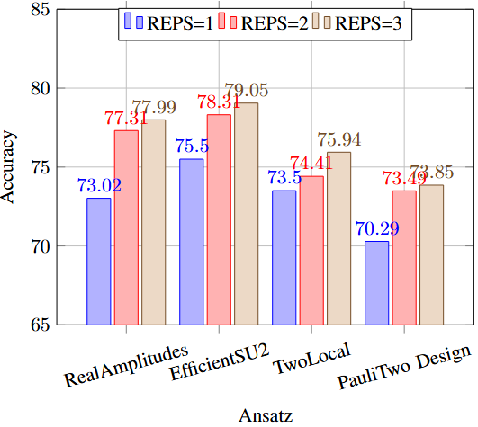
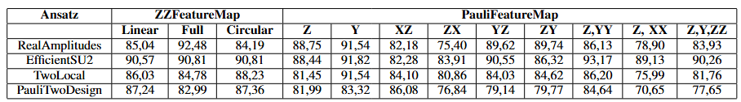
Optimization and Results
VQC – Ansatz and FeatureMap
4 ansatzes, 1-3 reps
ZZFeatureMap and EfficientSU2 best stability in performance
PauliFeatureMap good performance but unstable
Quantum Machine Learning for Intrusion Detection on Noisy Quantum Computers – Franco Cirillo – fracirillo@unisa.it
Notes:
EfficientSU2 is the ansatz that performs best on average and achieves the highest maximum values across all repetition settings.
RealAmplitudes is another ansatz that performs well,
TwoLocal shows lower performance compared to the other two ansatzes but remains consistent.
PauliTwoDesign has the worst performance, even though it improves with the number of repetitions
After confirming that r=3 is the best of the tested configurations for the ansatz, we analyze the results obtained with this value and show the best configurations in Table
The results show that \textit{PauliFeatureMap [X]} and \textit{PauliFeatureMap [XX]} cannot classify the data effectively, regardless of the feature map used or the number of qubits; for this reason it has not been put in the Table \ref{tab:featuremaps_max}. Conversely, the \textit{ZZFeatureMap}, in all its entanglement variants, exhibits superior performance, with higher average and maximum values compared to other configurations.
Applying the VQC to this dataset reveals that configurations involving an \(X\)-rotation tend to yield lower results compared to those using \(Z\)- and \(Y\)-rotations. Additionally, it can be observed that \textit{PauliFeatureMap [Y]} achieves very high values across all ansatz combinations.

Slide 24
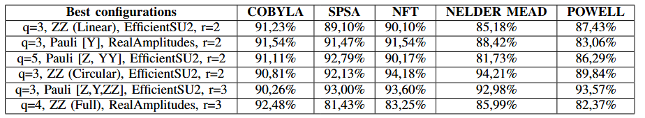
Optimization and Results
VQC – Optimizers and best configurations
Qubits 3-5
COBYLA generally achieves the highest accuracies and is the most stable.
SPSA and NFT also perform well, but are less stable
NELDER MEAD and POWELL achieve competitive results only in specific cases.
Quantum Machine Learning for Intrusion Detection on Noisy Quantum Computers – Franco Cirillo – fracirillo@unisa.it
Notes:
We tested 5 optimizers
Among the optimizers, COBYLA generally achieves the highest accuracies,
SPSA and NFT also perform well, but are less stable
Interestingly, NELDER MEAD and POWELL achieve competitive results in specific cases, such as q=3, ZZFeatureMap (Circular), EfficientSU2, r=2, where NELDER MEAD achieves 94.21\% accuracy.
The findings suggest that the choice of optimizer significantly impacts performance and should be carefully selected based on the configuration and circuit design.

Slide 25
Optimization and Results
VQC – Noisy simulation
The configuration 3 QUBIT, PauliFeatureMap [Y], RealAmplitudes(reps=2), SPSA consistently delivers the best overall results with accuracy above 91\% and F1-Score up to 94.19\%.
In contrast, the configuration 5 QUBIT, PauliFeatureMap [Z, YY], EfficientSU2 (REPS=2), SPSA shows significant performance drops, especially on Fake Lagos and Fake Perth.
FakeNairobi and FakePerth perform better than FakeLagos with circuits that require more entanglement, such as the ZZFeatureMap, and with EfficientSU2, which are more complex compared to Real Amplitudes.
Quantum Machine Learning for Intrusion Detection on Noisy Quantum Computers – Franco Cirillo – fracirillo@unisa.it
Notes:
The configuration 3 QUBIT, PauliFeatureMap [Y], RealAmplitudes(REPS=2), SPSA consistently delivers the best overall results, achieving high accuracy, precision, recall, and F1-scores across all noise models, with accuracy above 91\% and F1-Score up to 94.19\%. In contrast, the configuration 5 QUBIT, PauliFeatureMap [Z, YY], EfficientSU2 (REPS=2), SPSA shows significant performance drops, especially on Fake Lagos and Fake Perth, with balanced accuracies falling to 50.00\%.
FakeNairobi and FakePerth perform better than FakeLagos with circuits that require more entanglement, such as the ZZFeatureMap, and with EfficientSU2, which is more complex compared to Real Amplitudes.

Slide 26
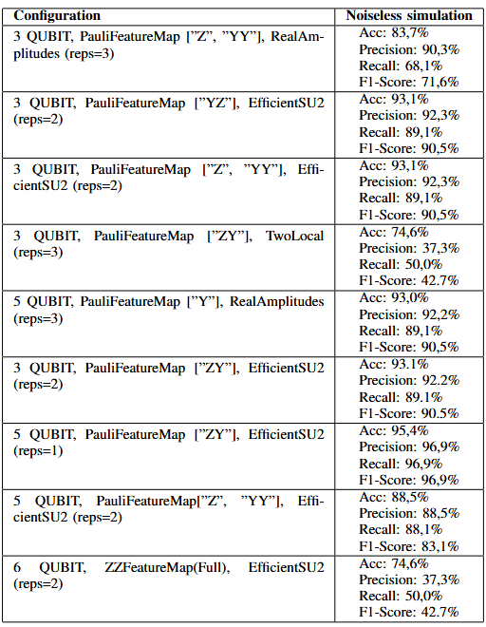
Optimization and Results
Hybrid – Fine-tuning
Simpler circuits contributes to optimizing the performance
Qubit 3-5
Quantum Machine Learning for Intrusion Detection on Noisy Quantum Computers – Franco Cirillo – fracirillo@unisa.it
Notes:
Since the context involves neural networks, the analysis from the VQC model was utilized as a starting point to select the best combinations of feature maps and ansatzes.
From the results obtained with a noiseless simulator in Table, it emerges that the use of simpler circuits contributes to optimizing the performance of the hybrid network.
With 3 qubits, a good performance value was achieved was with an accuracy of 93.1\%. However, transitioning from 3 to 5 qubits, combined with a lower number of repetitions in the circuit, led to the overall best performance of the model, with 95.4\% of accuracy and 96.9\% of F1-score.

Slide 27
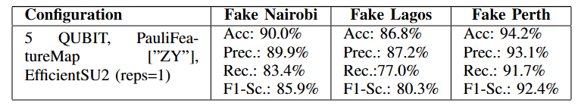
Optimization and Results
Hybrid – Noisy simulation
Results are highly dependent on the backend used.
Drop in performance with FakeLagos, due to greater sensitivity to errors in two-qubit gates.
FakePerth maintains a consistent level of performance.
Quantum Machine Learning for Intrusion Detection on Noisy Quantum Computers – Franco Cirillo – fracirillo@unisa.it
Notes:
Analyzing this optimal configuration under noisy conditions, reported in Table, reveals that the results are highly dependent on the backend used. For instance, in the case of FakeLagos, there is a noticeable drop in performance, likely due to greater sensitivity to errors in two-qubit gates given PauliFeatureMap [”ZY”] and EfficientSU2, while FakePerth maintains a consistent level of performance, achieving an accuracy of 94.2\% and an F1-score of 92.4\%.

Slide 28
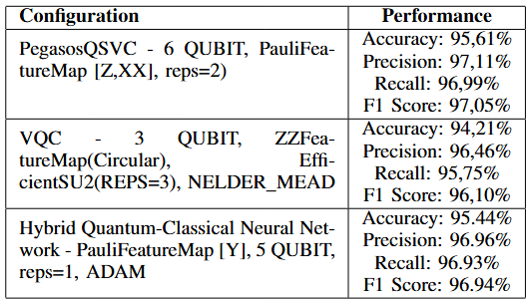
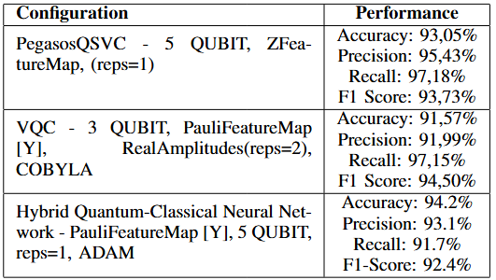
Result Analysis
Noiseless
Pegasos-QSVC stands out for achieving better performance than VQC.
VQC delivers strong results, but their performance is highly sensitive to parameters, requiring systematic testing.
The hybrid neural network performs well, showcasing the benefits of combining classical and quantum paradigms for robust and efficient models.
Noisy
Quantum Machine Learning for Intrusion Detection on Noisy Quantum Computers – Franco Cirillo – fracirillo@unisa.it
Notes:
Best results for each QML algorithm are summarized in Table respectively for noiseless and noisy simulations.
Pegasos-QSVC stands out for achieving better performance than VQC. This result highlights the efficiency of simpler, optimization-focused approaches when compared to more complex variational models.
VQC also delivers strong results, however, their performance is highly sensitive to parameters like qubit count, circuit depth, and optimization methods, requiring systematic testing to identify optimal configurations.
The hybrid neural network performs well in noiseless simulations, showcasing the benefits of combining classical and quantum paradigms for robust and efficient models.
However, these results do not always translate to noisy environments, where performance can drop significantly for certain backends.

Slide 29

Result Analysis
QML models are heavily influenced by the noise characteristics of the simulated quantum backends.
Once the real quantum machine for training is selected, it is useful to assess the machine's resistance to two-qubit gate errors in order to decide the circuit structure to execute.
Machines more sensitive to these errors may require circuits with less entanglement, while machines less prone to errors can handle more complex circuits with greater entanglement.
Quantum Machine Learning for Intrusion Detection on Noisy Quantum Computers – Franco Cirillo – fracirillo@unisa.it
Notes:
In general, the performance of QSVC, VQC, and hybrid quantum-classical networks is heavily influenced by the noise characteristics of the simulated quantum backends.
The results suggest that once the real quantum machine for training is selected, it is useful to assess the machine's resistance to two-qubit gate errors in order to decide the circuit structure to execute.
Specifically, machines more sensitive to these errors may require circuits with less entanglement, while machines less prone to errors can handle more complex circuits with greater entanglement.

Slide 30
Conclusion
QSVM, VQC, and a custom hybrid quantum-classical neural network have been analyzed for their application in intrusion detection in networks.
The fine tuning on noisy simulator reaches an accuracy of 93.05% with Pegasos-QSVC and 94.2% with the hybrid quantum-classical model.
Future research could focus on expanding the range of datasets and, when the use of real quantum machine will be more affordable, testing on real quantum hardware.
Quantum Machine Learning for Intrusion Detection on Noisy Quantum Computers – Franco Cirillo – fracirillo@unisa.it
Notes:
In this work, three QML models, QSVM, VQC, and a custom hybrid quantum-classical neural network, have been analyzed for their application in intrusion detection in networks.
The fine tuning on noisy simulator reaches an accuracy of 93.05% with Pegasos-QSVC and 94.2% with the hybrid quantum-classical model.
Future research could focus on expanding the range of datasets and, when the use of real quantum machine will be more affordable, testing on real quantum hardware.

Slide 31
Franco Cirillo and Christian Esposito
Quantum Machine Learning for Intrusion Detection on Noisy Quantum Computers
Contact: fracirillo@unisa.it

